Slide 1
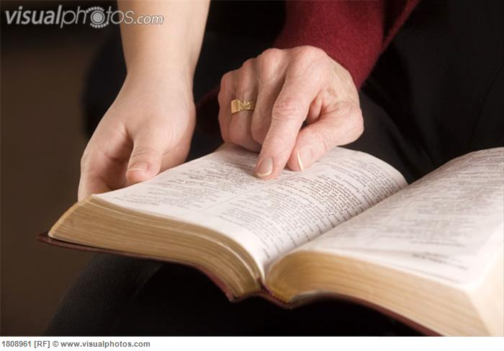
It’s the Only Way to Live
“What Hath the Lord Spoken?” – Jeremiah 23:37

Slide 2
Is This the Kind of World You Want to Live In?
But understand this, that in the last days there will come times of difficulty. ² For people will be lovers of self, lovers of money, proud, arrogant, abusive, disobedient to their parents, ungrateful, unholy, ³ heartless, unappeasable, slanderous, without self-control, brutal, not loving good, ⁴ treacherous, reckless, swollen with conceit, lovers of pleasure rather than lovers of God, -- 2 Timothy 3:1-4 ESV

Slide 3
Life that now is…
Many in the world “live for the day” and don’t believe or care about an after life.
Some Christians are looking to go to heaven, but don’t see the earthly benefits of living according to God’s Word. To them the Christian life is drudgery.
Paul: “…godliness is profitable for all things, having promise of the life which now is, and of that which is to come.” (1 Timothy 4:8)

Slide 4
I Can Have Confidence in salvation…
Why is that important? Luke 13:23-27 - Then one said to Him, "Lord, are there few who are saved?" And He said to them, ²⁴ "Strive to enter through the narrow gate, for many, I say to you, will seek to enter and will not be able. ²⁵ When once the Master of the house has risen up and shut the door, and you begin to stand outside and knock at the door, saying, 'Lord, Lord, open for us,' and He will answer and say to you, 'I do not know you, where you are from,' ²⁶ then you will begin to say, 'We ate and drank in Your presence, and You taught in our streets.' ²⁷ But He will say, 'I tell you I do not know you, where you are from. Depart from Me, all you workers of iniquity.' (NKJV)

Slide 5
I Can Have Confidence in salvation…
We can know what to do to be saved – Mk. 16:15, 16
Just one Gospel that saves - Gal. 1:6-9
We obey the Gospel to be made pure - 1 Peter 1:22, Since you have purified your souls in obeying the truth through the Spirit in sincere love of the brethren, love one another fervently with a pure heart, ²³ having been born again, not of corruptible seed but incorruptible, through the word of God which lives and abides forever…. ²⁵ Now this is the word which by the gospel was preached to you. (NKJV)

Slide 6
I Can Have Confidence in salvation…
We can know what to do to be saved – Mk. 16:16
Know that as a Christian I sin, I can be forgiven no matter how bad the sin…
1 John 1:7-9 - but if we walk in the light, as he is in the light, we have fellowship one with another, and the blood of Jesus his Son cleanseth us from all sin. ⁸ If we say that we have no sin, we deceive ourselves, and the truth is not in us. ⁹ If we confess our sins, he is faithful and righteous to forgive us our sins, and to cleanse us from all unrighteousness.

Slide 7
confidence that worship is acceptable…
Why is that important? God is looking for a specific worshipper – Jn. 4:23
Prayers are heard – James 1:5;17; Rev. 5:8
Lord’s supper is beneficial – 1 Cor. 11:23-29
Singing is truly uplifting – Eph. 5:18, 19
Preaching is accepted – 2 Cor. 2:17; 2 Tim. 2:4

Slide 8
I Can Have life of peace and rejoicing…
Why important? Otherwise we are miserable – 1 Cor. 15:19
Peace in family, marriage, the work place, the church
Peace with those who misuse us – 1 Th. 1:4; Mt. 5:10-12
Imagine a life w/o lying, graft, anger, greed, arrogance = imagine being at peace with self and others… In Christ, it’s real! Families do stay together! Marriages last 60 yrs.+!
A life of love is a life that will receive love – 1 Cor. 13:3-8

Slide 9
Confidence we will have eternal life…
Why important ? Not all will! – John 5:26-29; Mt. 25:31-46
Our hearts are assured – 1 John 3:19-24
What men say won’t matter – Rom. 14:12; 1 Cor. 4:3, 4
Are You Living the Only Way to Live?
If Not, Why Not Start Tonight?

